Slide 1
Agile Project Management

Slide 2
Introduction
Agile Project Management (APM) is an iterative approach to planning and guiding project processes.
Just as in Agile Software Development, an Agile project is completed in small sections
These sections are called iterations
In Agile Software Development, for instance, an iteration refers to a single development cycle

Slide 3
Each section or iteration is reviewed and critiqued by the project team, which should include representatives of the project's various stakeholders
Insights gained from the critique of an iteration are used to determine what the next step should be in the project
Agile model emphasise face-to-face communication over written documents.
It is recommended that the development team size be deliberately kept small (5–9 people) to help the team members meaningfully engage in face-to-face communication and have collaborative work environment.

Slide 4
Agile Manifesto :
Working software over comprehensive documentation.
Frequent delivery of incremental versions of the software to the customer in intervals of few weeks.
Requirement change requests from the customer are encouraged and are efficiently incorporated.
Enhanced communication among the development team members through face-to-face communication rather than through exchange of formal documents.
Continuous interaction with the customer is considered much more important rather than effective contract negotiation. A customer representative is required to be a part of the development team, thus facilitating close, daily co-operation between customers and developers.

Slide 5
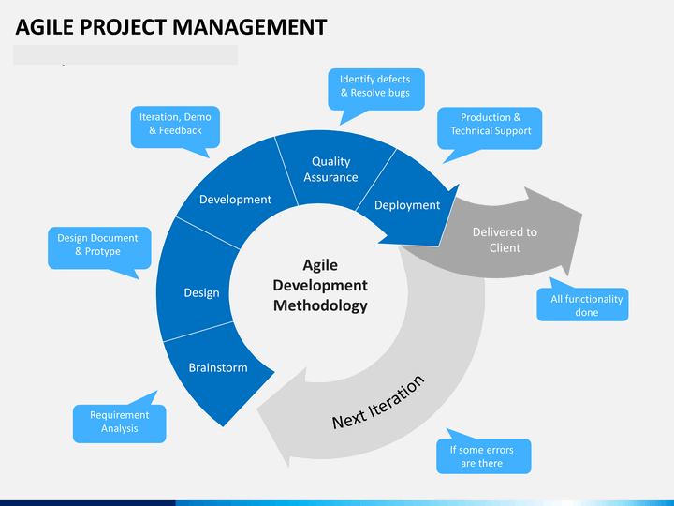

Slide 6
Advantages and disadvantages of agile methods:
The agile methods derive much of their agility by relying on the tacit knowledge of the team member about the development project and informal communications to clarify issues, rather than spending significant amounts of time in preparing formal documents and reviewing them.
Lack of formal documents leaves scope for confusion and important decisions taken during different phases can be misinterpreted at later points of time by different team members.
In the absence of any formal documents, it becomes difficult to get important project decisions such as design decisions to be reviewed by external experts.
When the project completes and the developers disperse, maintenance can become a problem.

